Slide 1
No Weekends Final Presentation S O F T W A R E E N G I N E E R I N G Wilson | Ming Kwang | Cristabel | Yew Kit | Eugene

Slide 2
Agenda
Schedule
Metrics
GIT Usage
Fun Facts
Main Takeaways
Team Issues

Slide 3
Schedule
Who do? You do? I do?

Slide 4
Iteration 1
(30/8 – 18/9)
Iteration 2
(20/9 – 25/9)
Tasks
Planning
Diagrams
Tasks
DB Setup
Login/Logout
View Courses
Search Courses

Slide 5
Iteration 3
(26/9 – 9/10)
Iteration 4
(10/10 – 23/10)
Tasks
Bootstrap
Bidding Cart
Drop a Bid
Student Enrolled Courses
Start/End Round
View Bidding Results
Tasks
JSON Authenticate
JSON Delete Bid
JSON Drop Section
JSON Bootstrap
JSON Dump Bid
JSON Dump User
JSON Delete Bid
JSON Dump Table
JSON Start/Stop Round
Student Timetable
JSON Update Bid

Slide 6
Iteration 5
(24/10 – 6/11)
Iteration 6
(7/11 – 13/11)
Tasks
JSON Update Bid
Regression Testing and Debugging before deployment
Regression Testing and Debugging after deployment
Testing and Debugging UAT failures
Tasks
Update Diagrams
Testing and Debugging UAT failures
Java Docs
JSON Bid Status
Final Testing and Debugging before deployment
Final Testing and Debugging after deployment
Final Presentation Preparation

Slide 7
Iteration
Week
5
6
7
8
9
10
11
12
13
14
Planned
1
2
3
4
5
6
Actual
1
2
3
4
5
6
PM
Wilson
Ming Kwang
Eugene
Yew Kit
Cristabel

Slide 8
Functionalities & Libraries
What did we do/use?

Slide 9
Functionalities
Bidding Cart
Student Timetable

Slide 10
External Libraries
To read CSV
opencsv-3.8.jar
To interact with MySQL
MySQL JDBC Driver
To upload files
commons-fileupload-1.3.2.jar
commons-io-2.5.jar

Slide 11
External Libraries
To format and write JSON
gson-2.7.jar
JSON Web Token
is203-jwt-v2.jar
nimbose-jose-jwt-2.26.1.jar
For Student Timetable
Using opensource api - FullCalendar

Slide 12
Breakdown of Work
Share the love

Slide 13
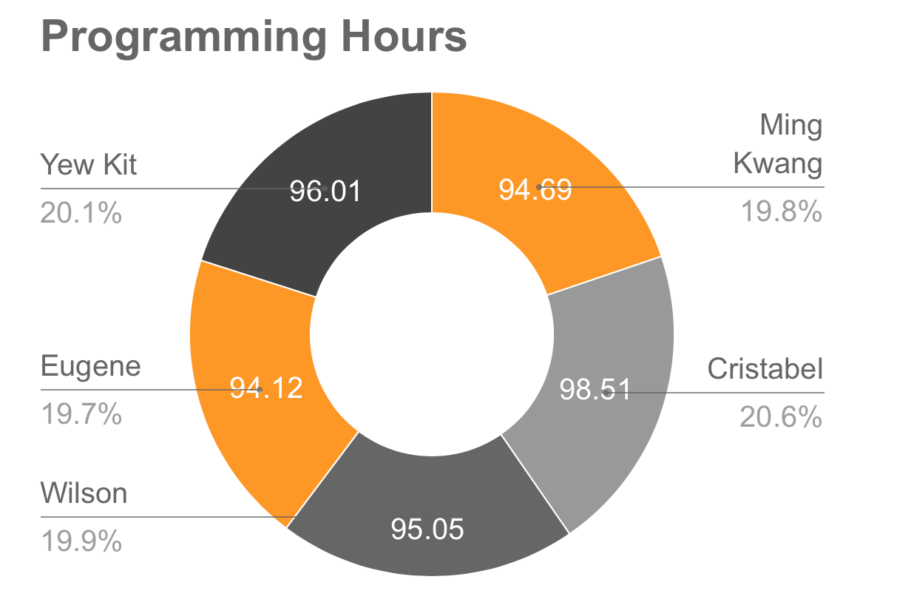

Slide 14
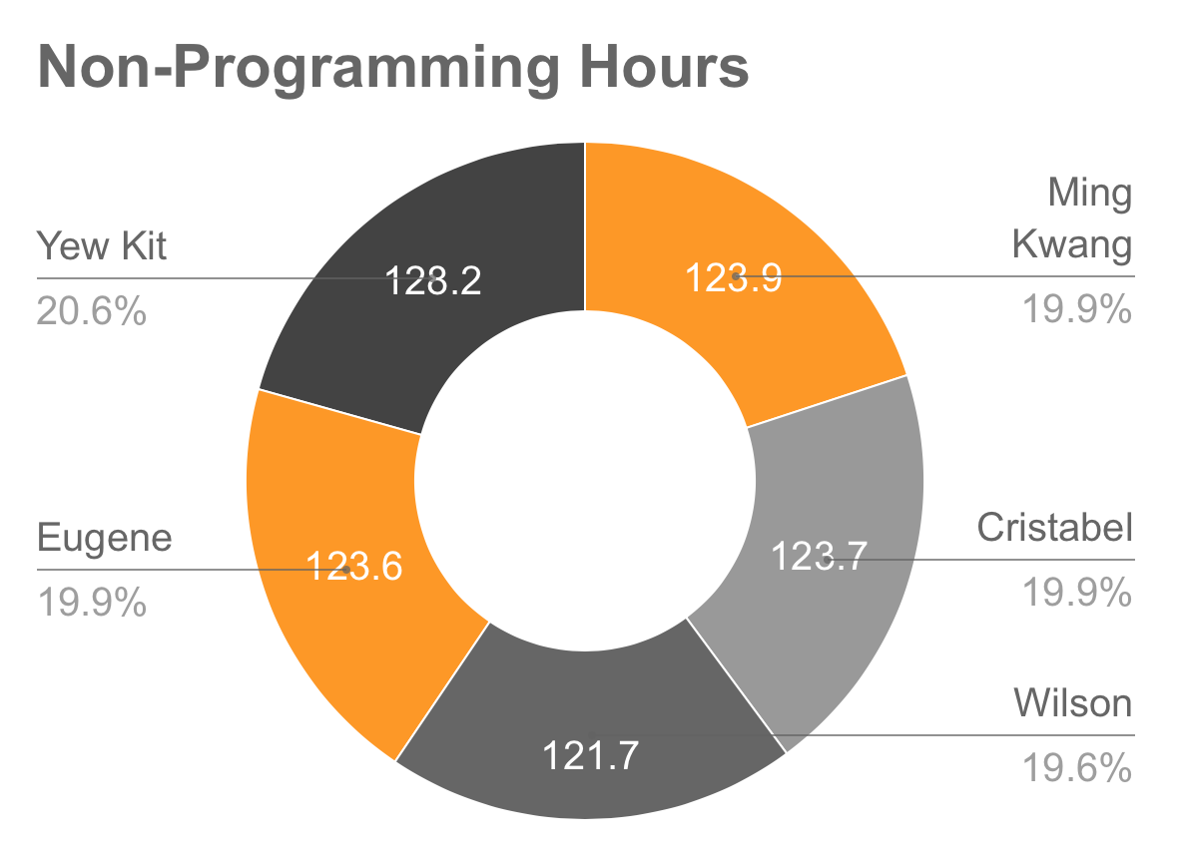

Slide 15
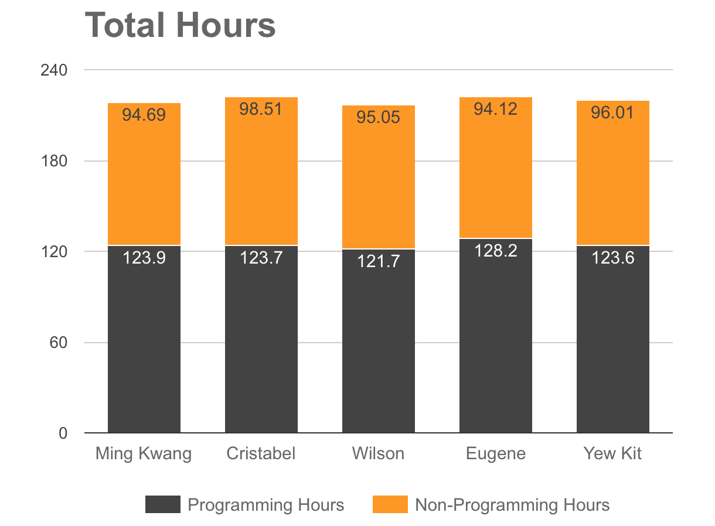

Slide 16
Tasks | Wilson | Ming Kwang | Eugene | Yew Kit | Cristabel
Login/Logout |  | ✓ | ✓
View / Search for Courses |  |  |  | ✓ | ✓
Bidding Cart (add / delete / check out) |  |  | ✓ | ✓
Drop a Bid |  |  | ✓ | ✓
View Student Enrolled Course / Drop a section |  |  | ✓ | ✓
View Bidding Result | ✓ |  |  |  | ✓
Bootstrap (unzip, validation, insert, error log) | ✓ | ✓ |  |  | ✓
Start / End Round (Clearing round) |  | ✓ |  |  | ✓
Student Timetable | ✓ |  |  | ✓
JSON | ✓ | ✓ | ✓ | ✓ | ✓
Notes:
Everybody pairs with each other at least once
JSON is split by accomodating task to ensure fair share of programming hours
Everyone is given a chance to work a complex function

Slide 17
Problems Faced when Tracking Schedule
Difficulty in gauging difficult of function and specific hours required for task
Changes/Addition to requirements

Slide 18
Metrics
How we judge ourselves

Slide 19
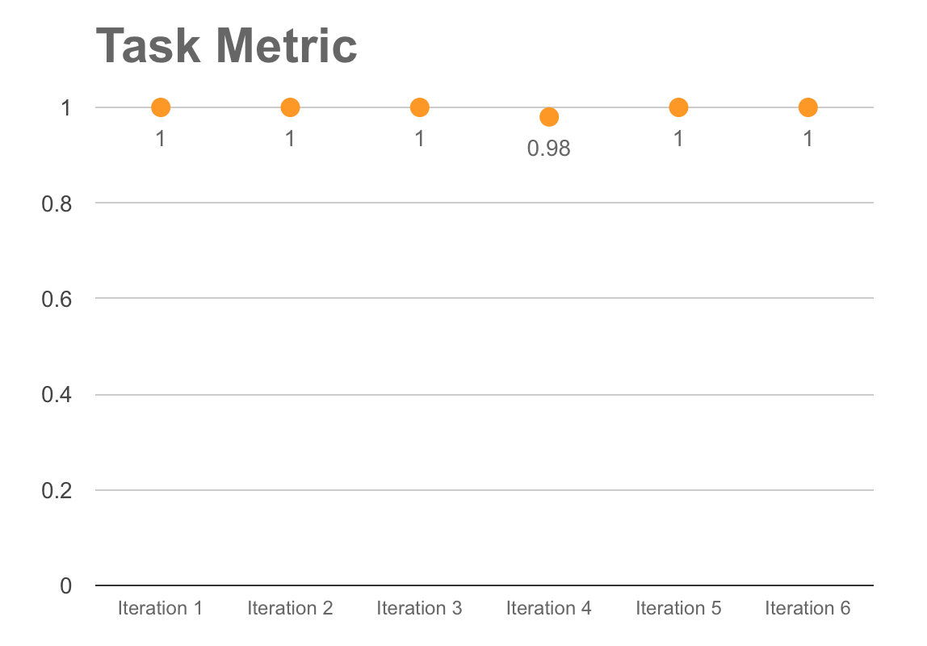
Overall TM: 99.7%

Slide 20
Task Metrics
How we used
Kept scores close to 1
Ensures that iterations are not overloaded
Gave buffer time to accommodate scheduling of brought over tasks

Slide 21
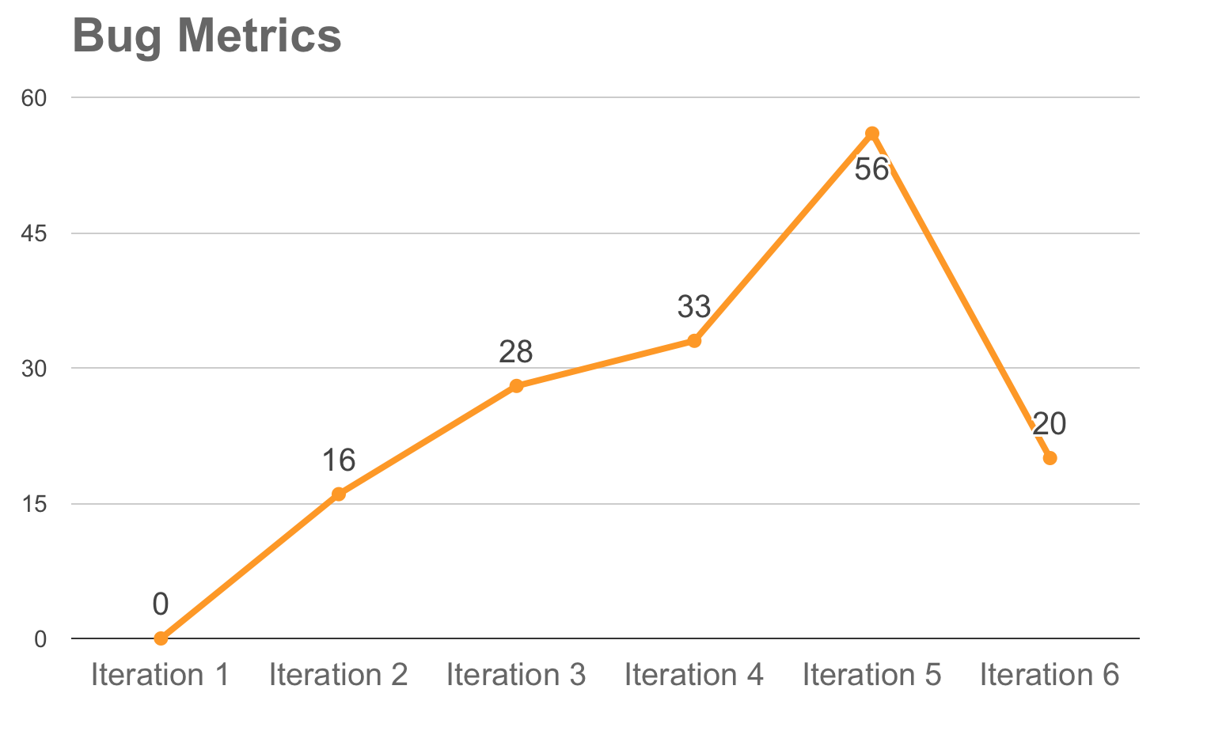

Slide 22
Bug Metrics
How we used
Utilized previous iteration scores to plan the number of testing and debugging sessions
Learn to estimate the duration needed for future debugging session based on the severity of bugs

Slide 23
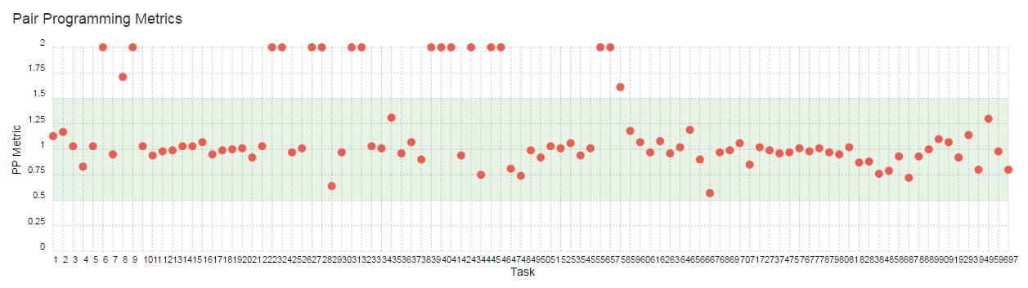

Slide 24
Challenges
Faced

Slide 25
Challenges Faced
Difficulty in assessing severity of bugs
Scores not tallying (human error)
Missing records

Slide 26
GIT Usage
Faster commit!

Slide 27
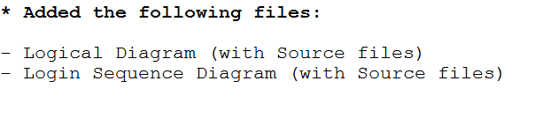
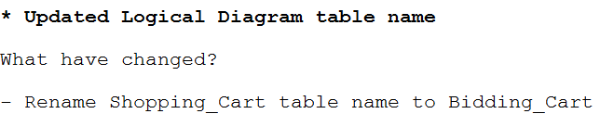

Slide 28
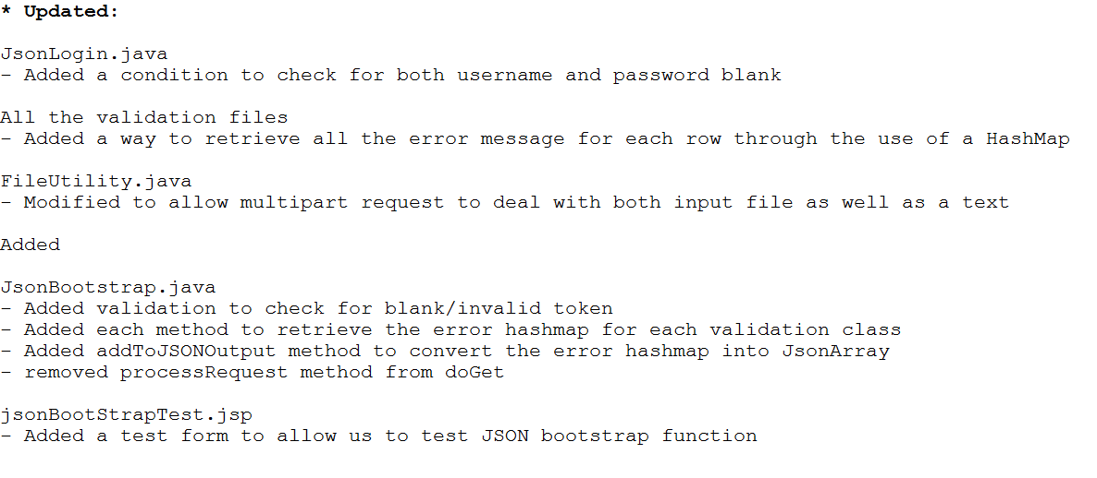

Slide 29
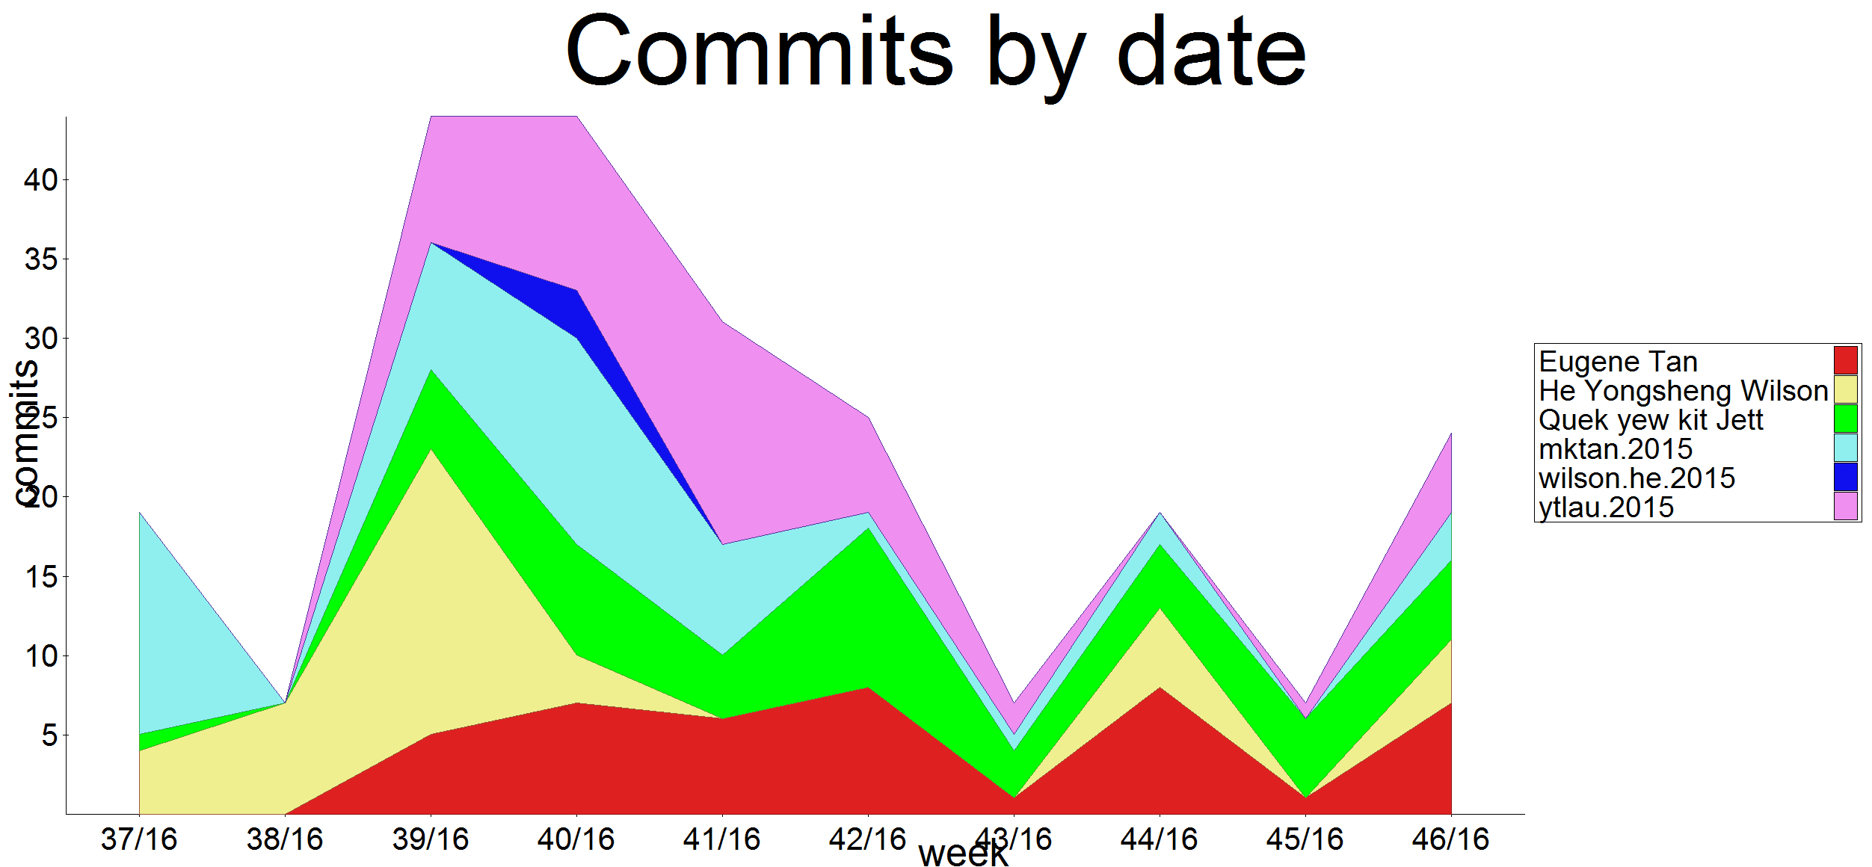

Slide 30
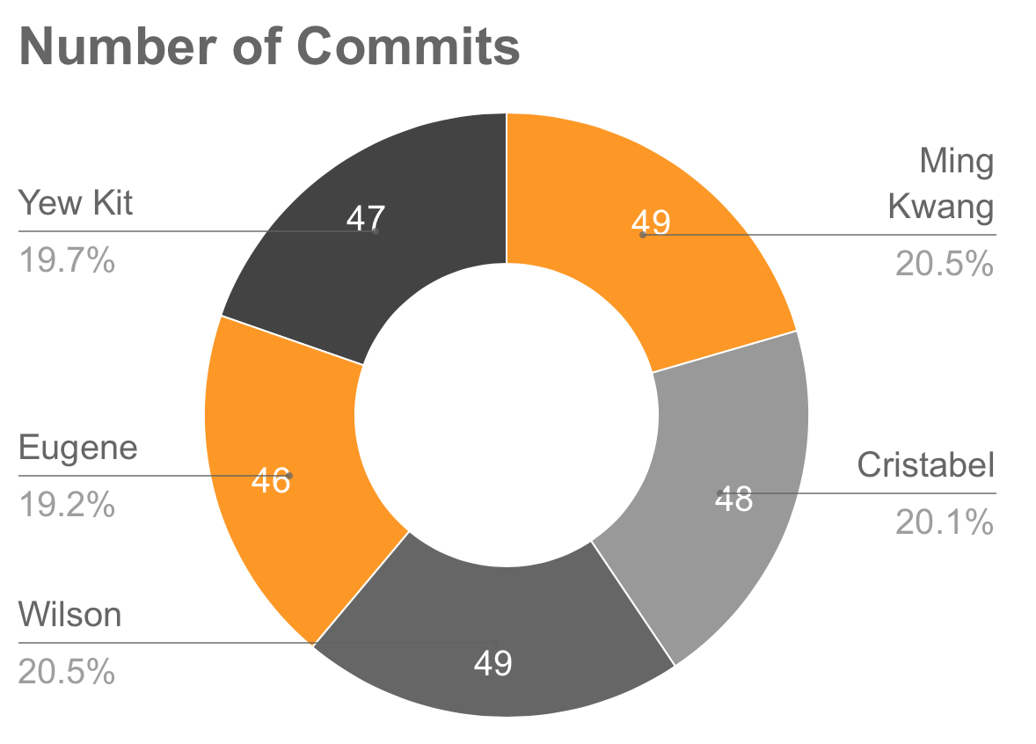

Slide 31
Team Issues
Time to “point fingers”

Slide 32
Learn from each other
Different style of coding
Lateness
Differing Ideas
Conflicting Schedules
Chiding
Open Discussions
Utilize weekends & recess weeks

Slide 33
Main Takeaways
What have we learnt?

Slide 34
Importance of collaboration
Importance of scheduling
Process of creating a software from scratch
One fix, more bugs

Slide 35
Expectation vs Reality
Importance of buffer time
Adapting to different working styles
Importance of code sharing

Slide 36
Fun Facts
Expose secrets liao

Slide 37
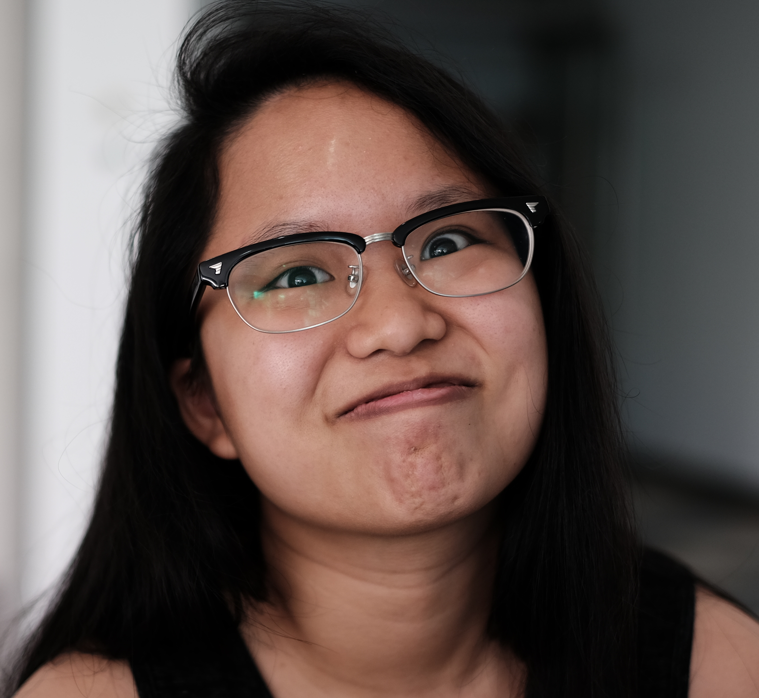
HELLO!
Cristabel
Crazy person to take CT, CAT, SE in 1 sem
Only owns 1 pair of shoes..
..until we came along

Slide 38
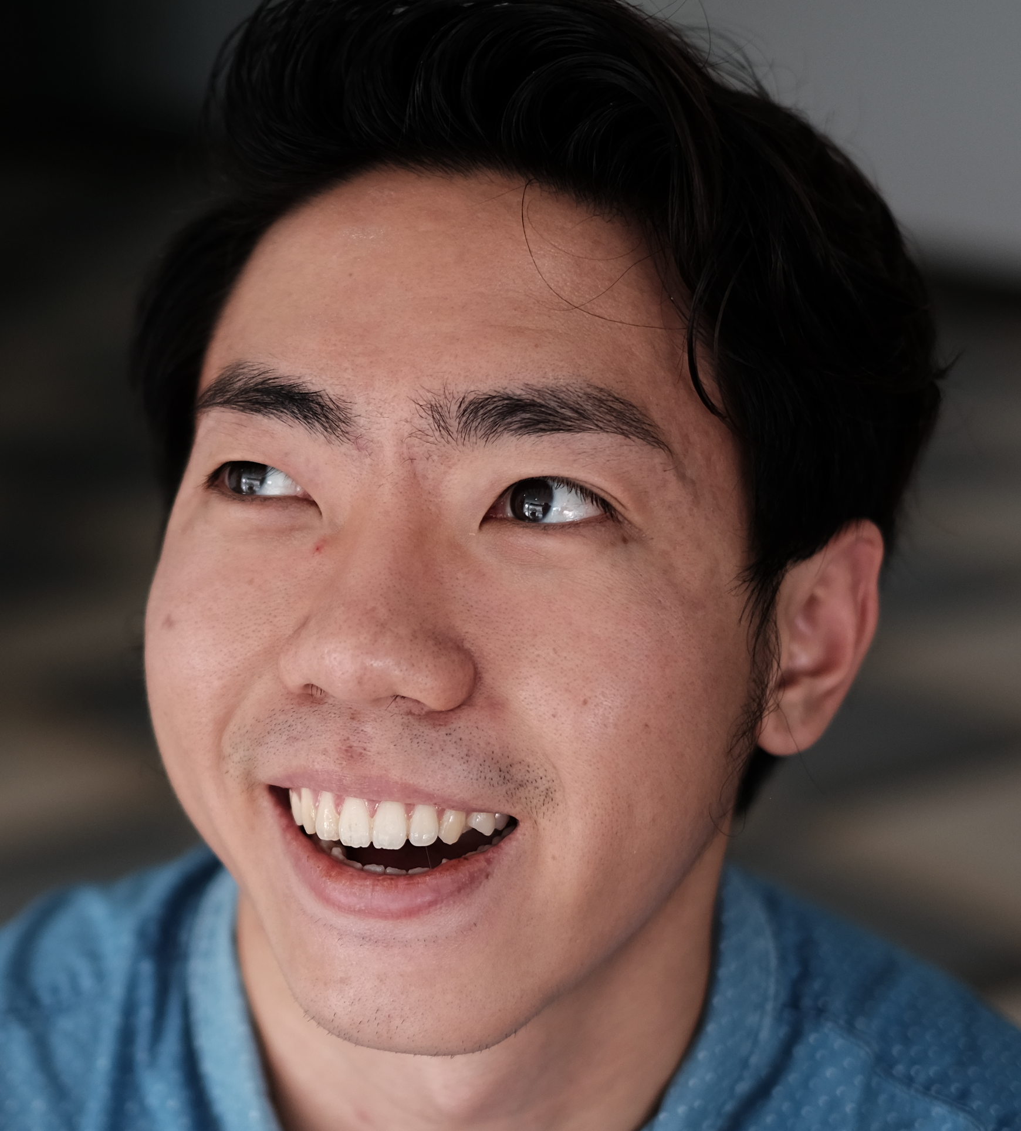
HELLO!
Eugene
Has 1k+ followers on Instagram (@awesome_eugene)
Does not eat fast food
Max Bidder for STAT101 (80+)

Slide 39
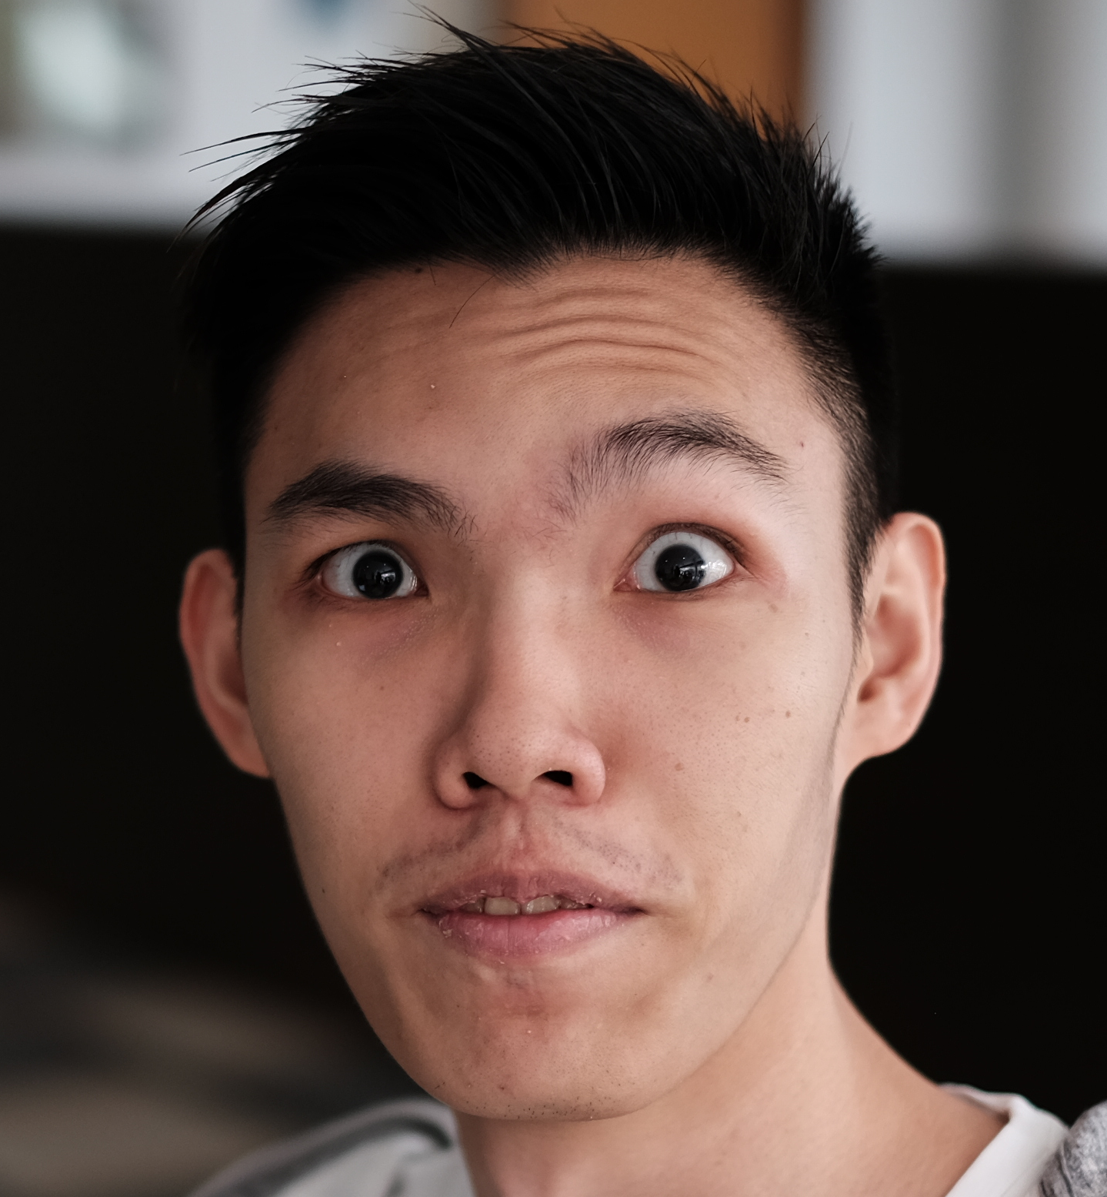
HELLO!
Wilson
Ultimate bug finder
Plays mousehunt on Facebook (@Wilson Ho)
Drinks his coffee only after 3 hours of leaving it out

Slide 40
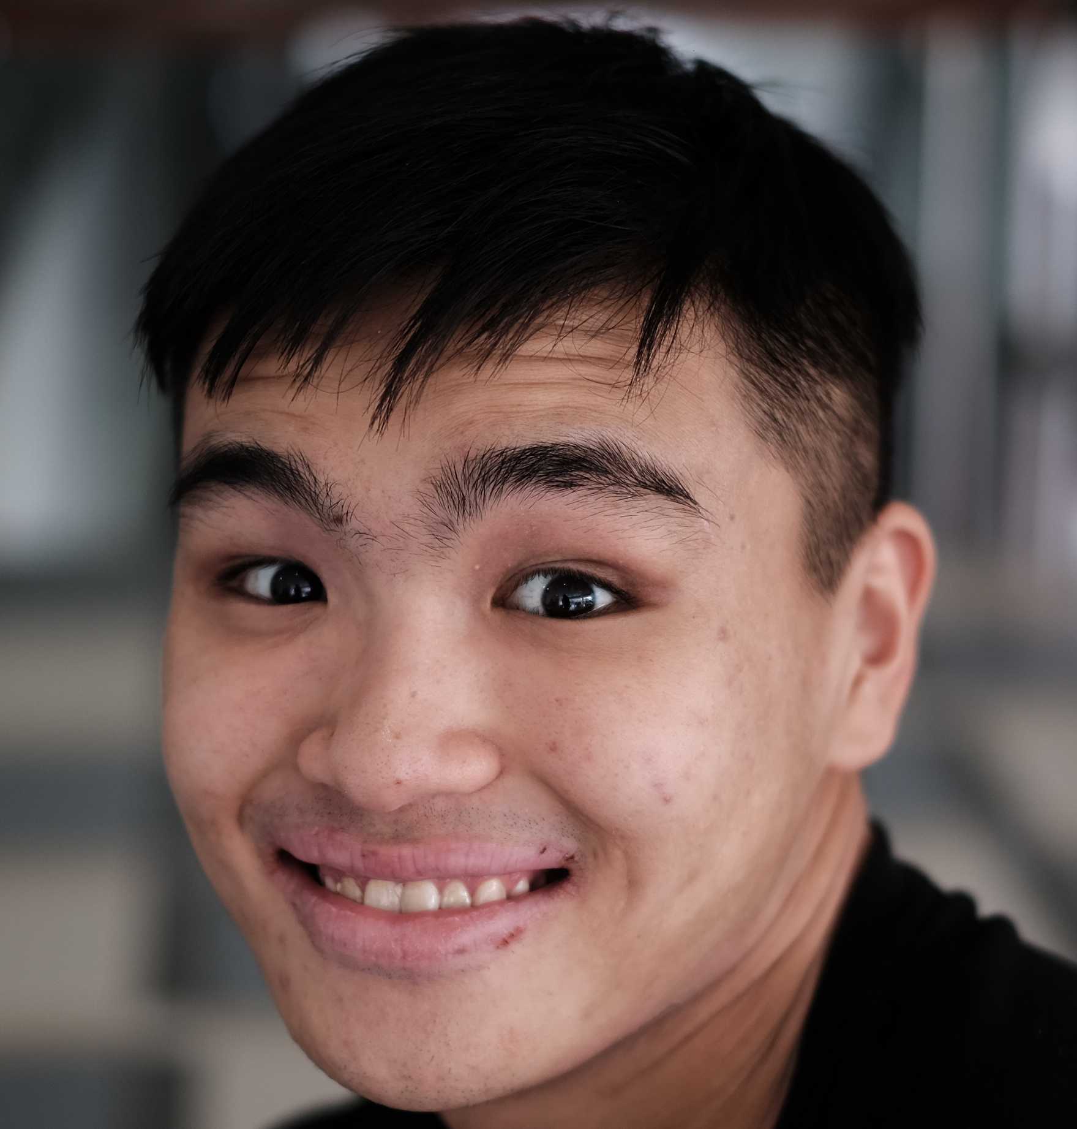
HELLO!
Yew Kit
Is active in BE & yoga master
Looking to sell his laptop (contact for more details)
Failed to snipe for CT

Slide 41
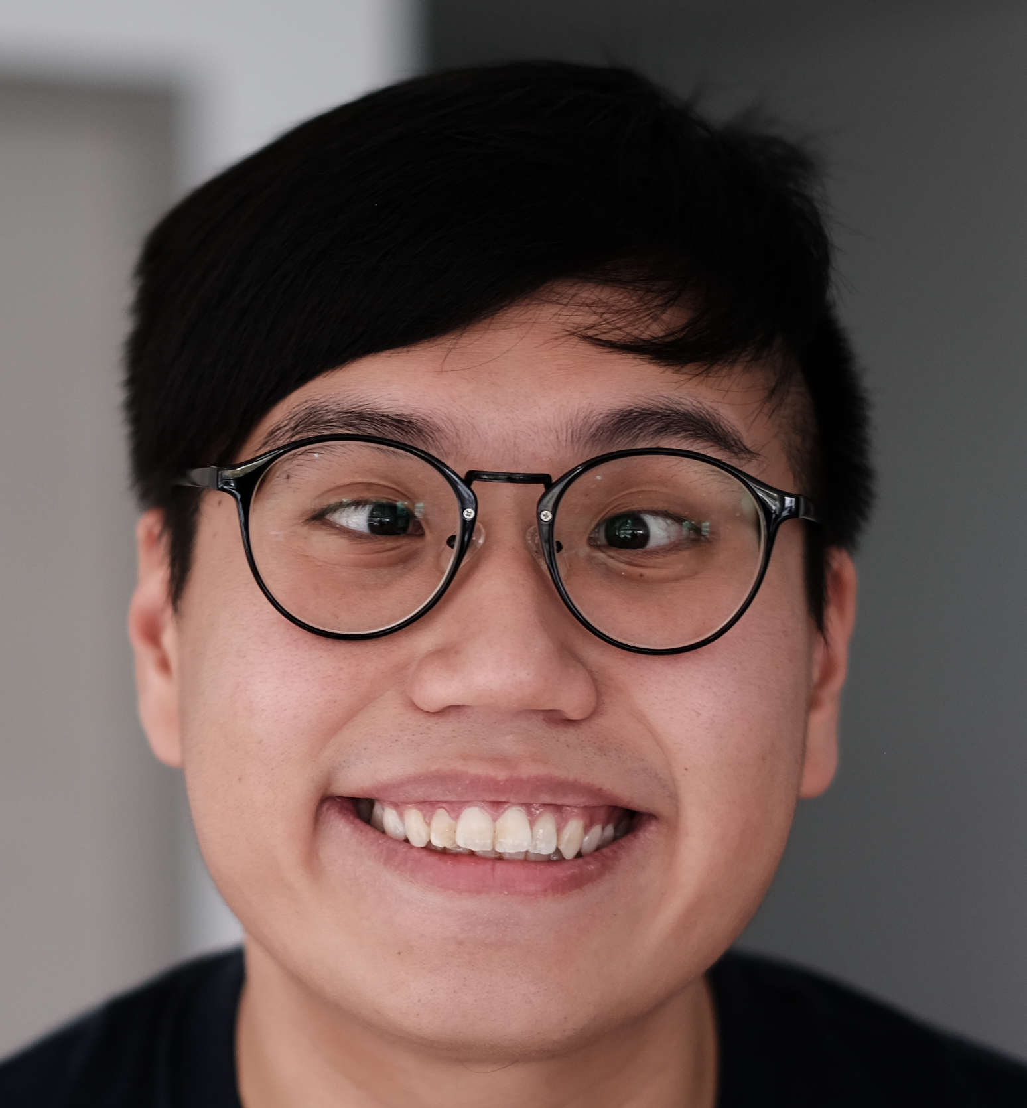
HELLO!
Ming Kwang
Takes really good photos
Jams whenever possible
Vegetarian & Mac Evangelist (Responsible for Jett’s laptop sale)

Slide 42
Thank
!
You
Please ask us nice question! ☺

